Slide 1
AHIA Claims Leakage & Fraud Forum Sydney November 2010
Dental Workshop
Dr Peter Clarke & Julie Heit

Slide 2
What do you want to achieve from this workshop?
Overview of the Dental Schedule
Item Numbers
Definitions
Correct use
Items prone to incorrect application
Item combinations and exclusivity
Items vs. age of patient
Up coding items
Standardization of Surface Descriptions and use of different restorative materials on the same tooth

Slide 3
What do you want to achieve from this workshop?
Other
Documentation and Record keeping
Permissions of auxillary staff
Treatment
Length of treatment
Limit of treatments
Frequencies and longevity of treatments
Tooth id

Slide 4
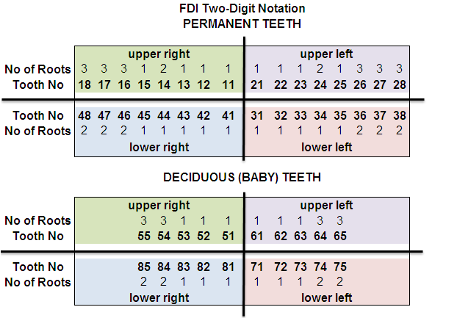
Tooth ID and Number of Roots per tooth

Slide 5
Buccal or Labial
Incisal
UPPER
Mesial
Mesial
Palatal
Mid Line
Lingual
Distal
Distal
LOWER
Occlusal

Slide 6
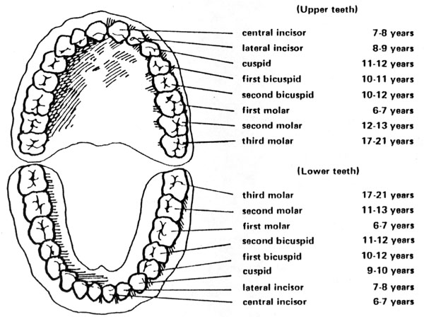
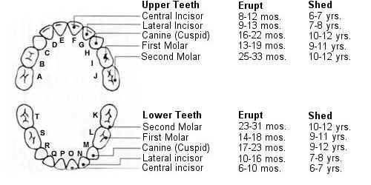
Tooth Eruption

Slide 7
Diagnostic Services
Examinations
011 Comprehensive oral examination
013 Oral examination – limited
014 Consultation
015 Consultation – extended (30 minutes or more)

Slide 8
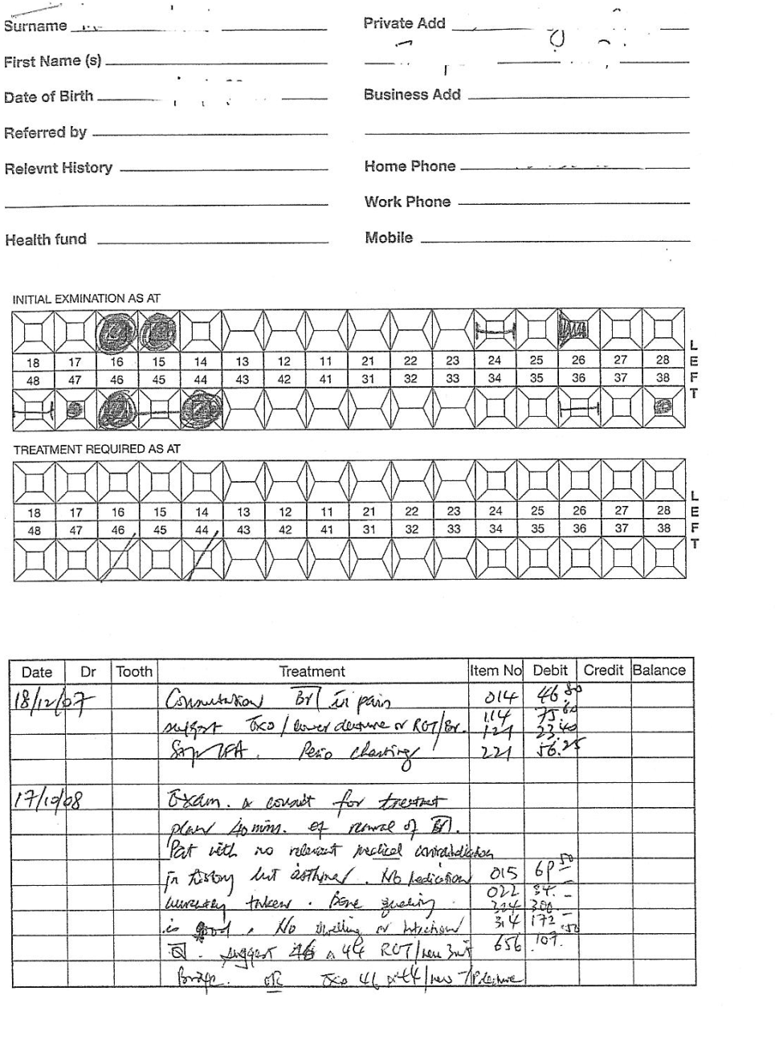
Patient Record Chart

Slide 9
Diagnostic Services
X-rays
022 Intraoral periapical or bitewing radiograph - per exposure
037 Panoramic radiograph – per exposure

Slide 10
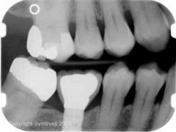
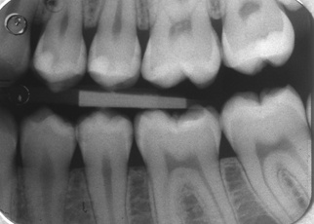
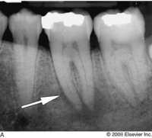
022 – Radiographs

Slide 11
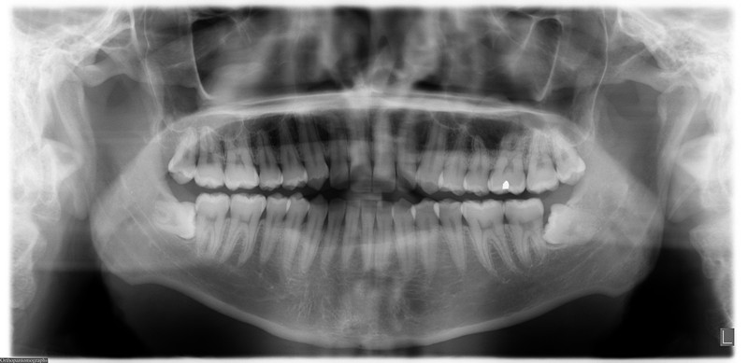
037 – OPG – Adult Dentition
18
15
14
17
16
13
12
11

Slide 12
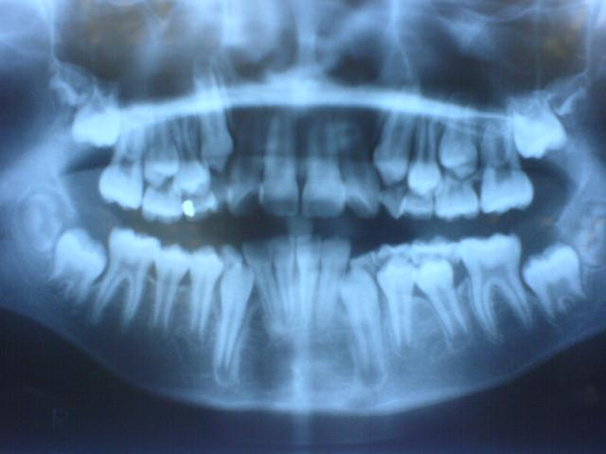
037 – OPG – Child Mixed Dentition
18
17
13
15
16
14
55
53
12
11
54

Slide 13
Diagnostic Services
Diagnostic Services
071 Diagnostic model – per model and 776 Impression – dental appliance repair/modification
072/073 Photographic records – intraoral and extraoral
074 Diagnostic Wax up

Slide 14
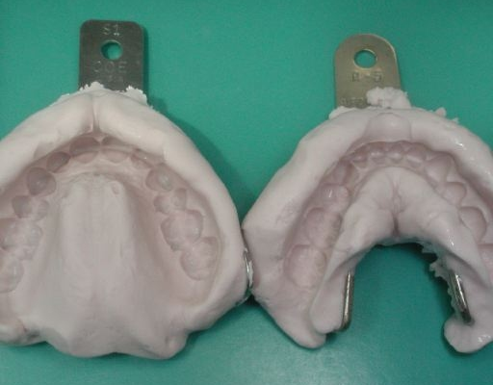
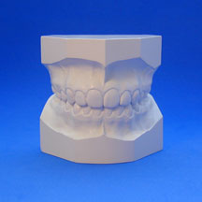
071 Diagnostic Models

Slide 15
Preventive Services
Dental Prophylaxis & Bleaching
111 Removal of plaque and/or stain
113 Recontouring of pre-existing restoration(s)
114 Removal of calculus – first visit
115 Removal of calculus – subsequent visit
116 Enamel micro-abrasion – per tooth
117 Bleaching, internal – per tooth
Remineralizing Agents
121 Topical application of remineralizing agent, one treatment (fluoride)
122 Topical remineralizing agent, home application – per arch
123 Concentrated remineralizing agent, application – single tooth
Other Preventative Services
153 Bi-maxillary mouthguard – indirect
161 Fissure sealing – per tooth
171 Odontoplasty – per tooth

Slide 16
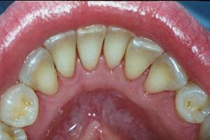
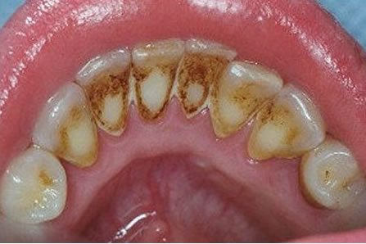
Preventive Services – 114 Scale & Clean

Slide 17
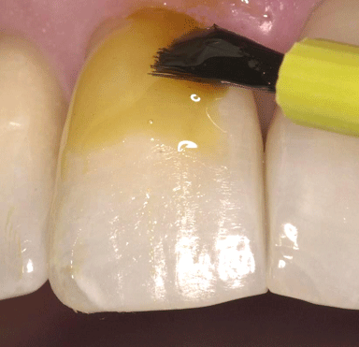
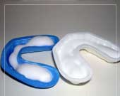
121 - Fluoride Treatment

Slide 18
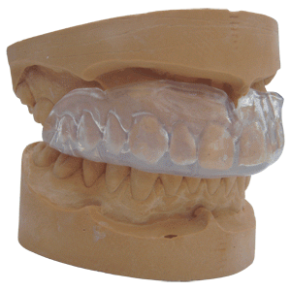
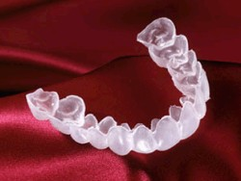
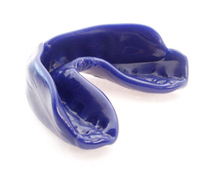
926 - Bleaching Tray
151 - Mouthguard

Slide 19
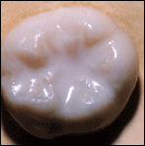
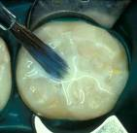
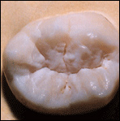
161 – Application of Fissure Seal

Slide 20
Periodontal Services
Periodontics
221 Clinical periodontal analysis and recording
222 Root planing and subgingival curettage – per tooth
231 Gingivectomy
232 Periodontal Flap Surgery per tooth
235 Gingival Graft per tooth or implant
236 Guided Tissue Regeneration per tooth or implant
237 Guided Tissue Regeneration membrane removal
238 Periodontal Flap Surgery for Crown Lengthening per tooth
245 Periodontal surgery involving one tooth or an implant
281 Course of non-surgical periodontal treatment
282 Continuation of periodontal treatment or maintenance subsequent to item 281

Slide 21
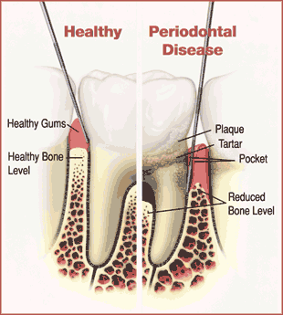
221 – Perio Recording

Slide 22
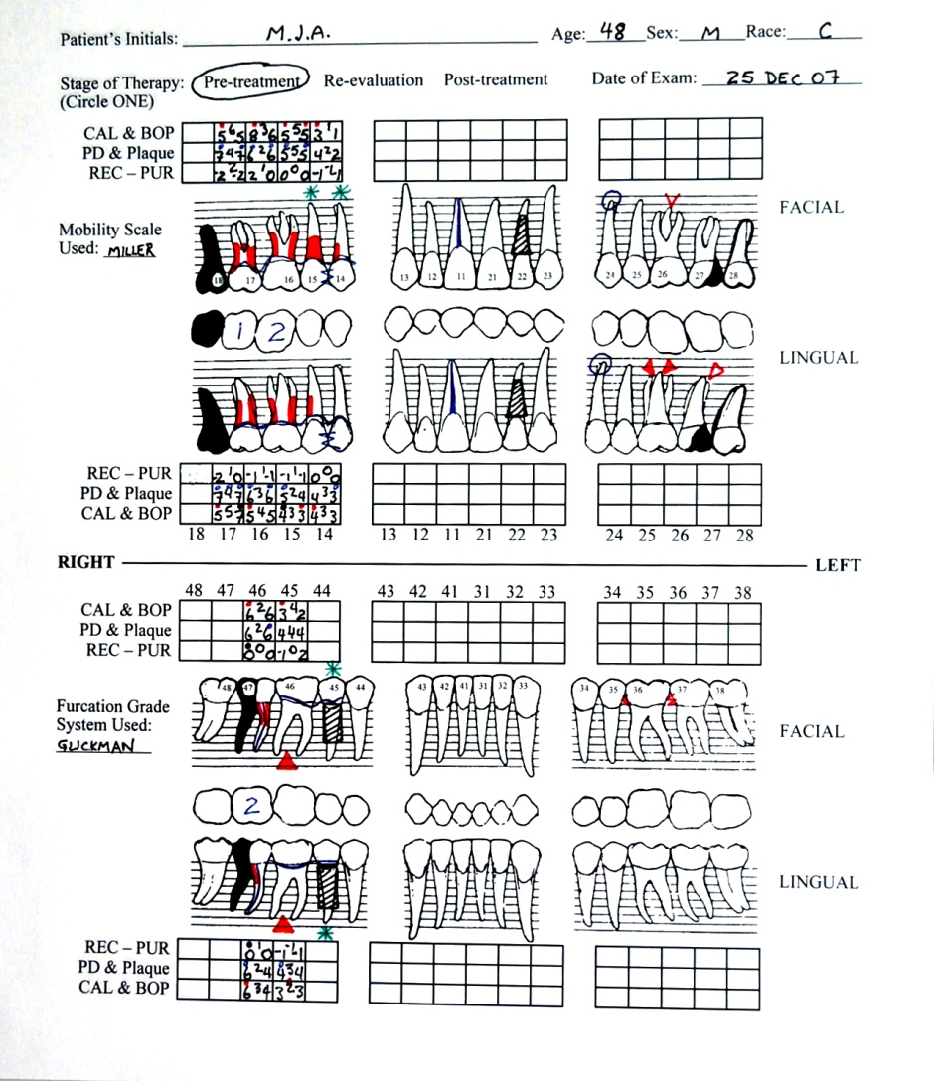
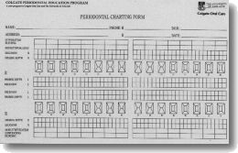
221 – Perio Recording Form

Slide 23
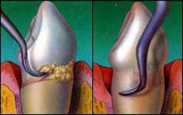
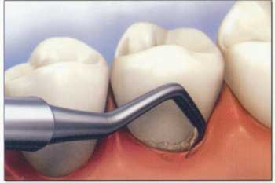
222 – Root Planing & Curettage

Slide 24
Extractions, Oral Surgery & Endodontics
Extractions & Oral Surgery
322 - 324 Surgical extractions
377 Removal or repair of soft tissue
399 Control of reactionary or secondary post operative haemorrhage
Endodontics
411 Direct pulp capping
419 Extirpation of pulp or debridement of root canal(s) – emergency or palliative
445 Exploration and/or negotiation of a calcified canal – per canal, per visit
451 Removal of root filling per canal
455 Additional visit for irrigation and/or dressing of the root canal system – per tooth
458 Interim therapeutic root filling – per tooth

Slide 25
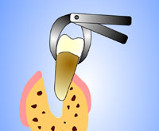
Extractions
311
314
324

Slide 26
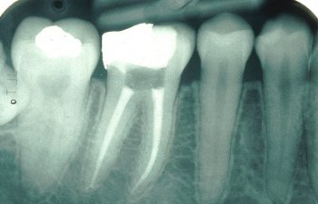
Root Canal Treatment
419
415
417

Slide 27
Restorative Services
Use of 531 and fissure seal item161 to the same surface
Upcoding of the number of surfaces restored
Routine billing of multiple fillings per tooth
Predominant use of posterior filling items to attract higher benefits
577 Cusp capping per cusp and 578 Restoration of an incisal corner per corner
Use of temporary filling item 572 during Root Canal Treatment (RCT)
Use of fillings in lieu of item 627, for cores for crowns, e.g. 535/577x4.

Slide 28
Various Fillings
511 One Surface
531 One Surface
514 Four Surface with 577 Cusp Cap
512 Two Surface
532 Two Surface
534 Four Surface with 577 Cusp Cap
513 Three Surface
553 Three Surface with 577 x 2 Cusp Cap
542 Two Surface x 4
533 Three Surface

Slide 29
Prosthodontic Services
Crowns & Bridge
611 Full crown – acrylic resin – indirect
613 Full crown – non metallic – indirect
625 Post and core for crown – indirect
627 Preliminary restoration for crown – direct
631 Provisional crown
632 Provisional bridge per pontic
Denture Items
741 Adjustment of denture
743 Relining complete denture processed
744 Relining partial denture processed
745 Remodelling complete denture
746 Remodelling partial denture
751 Relining complete denture direct
752 Relining partial denture direct
753 Cleaning and polishing of pre-existing denture

Slide 30
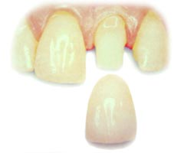
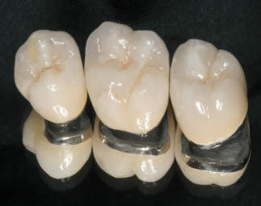
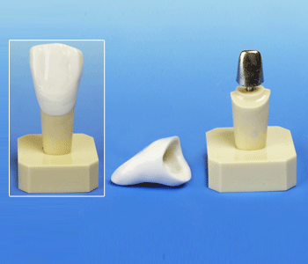
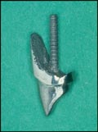
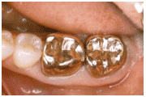
Crowns
613
615
615
618
613 and 625
625

Slide 31
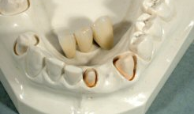
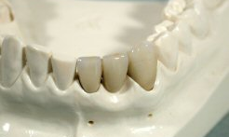
Bridges
643, 552 x 2
643, 615 x 2

Slide 32
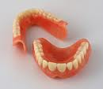
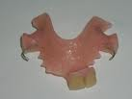
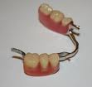
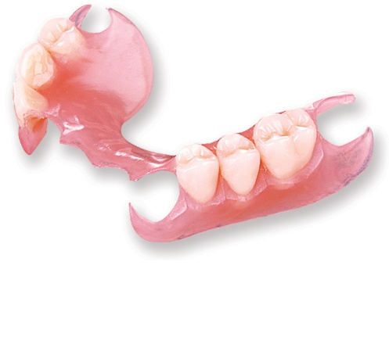
Various Dentures
711, 712 or 719
721, 733 x 2, 731 x 2
728, 733 x 6, 731 x 2, 732 x 3
727, 733 x 4, 732 x 2, 734 x 4
Valplast Denture – 722, 733 x 6
712, 735 x 2, 645 x 2

Slide 33
Orthodontic and Miscellaneous Services
Orthodontic
825 Sequential plastic aligners – per arch
Miscellaneous
911 Palliative care
961 Minor occlusal adjustment – per visit
963 Clinical occlusal analysis including muscle and joint palpation
964 Registration and mounting of models for occlusal analysis
968 Occlusal adjustment following occlusal analysis – per visit
983 and 984 Oral appliances for diagnosed snoring and obstructive snoring sleep apnoea

Slide 34
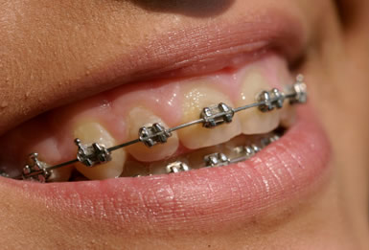
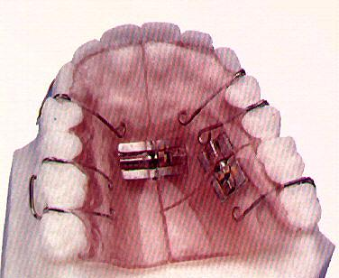
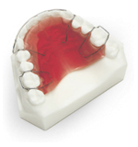
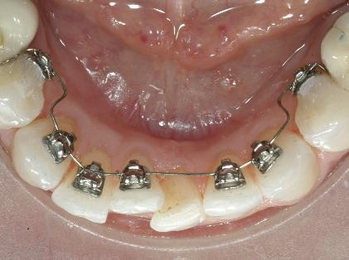
Orthodontic Appliances
831
811
821
825 Invisalign
829

Slide 35
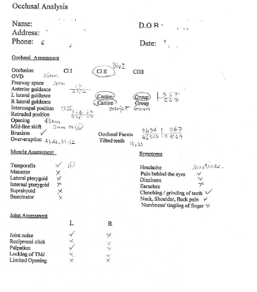
963 - Occlusal Analysis and Recording Form

Slide 36
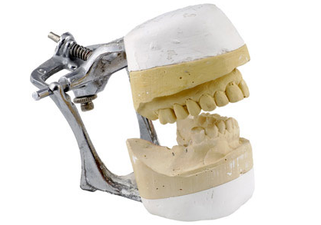
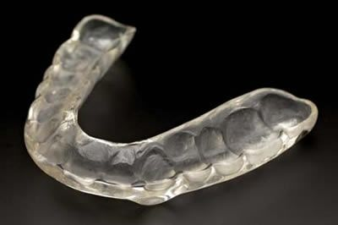
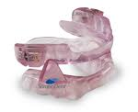
Mounting of models
965 Occlusal Splint
984 Bi-maxillary oral appliance for diagnosed snoring

Slide 37
Data Examples

Slide 41
Other
Documentation and Record keeping
Permissions of auxillary staff
Treatment
Times
Limiting number of treatments
Frequencies and longevity
Tooth id
Questions

